Slide 1
Elimination of Mosquitoes using Genetically Modified Mosquitoes Student Name: Naga G Javeri Potiwal Student Id: 20856699

Slide 2
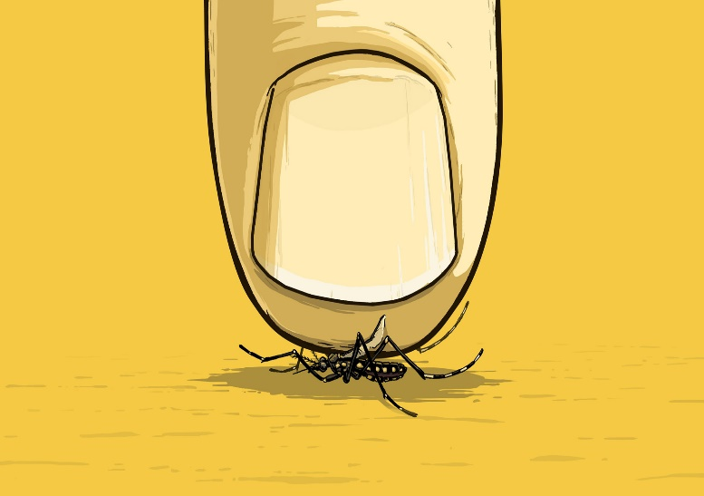
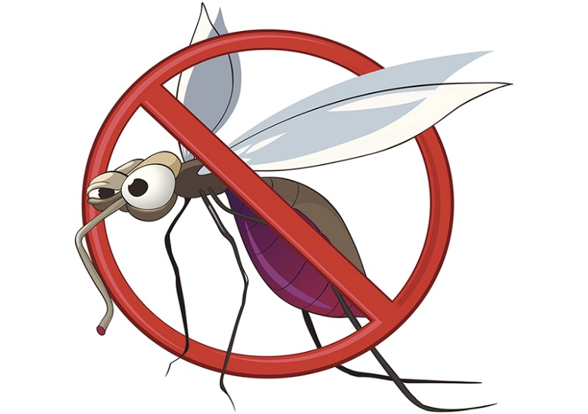
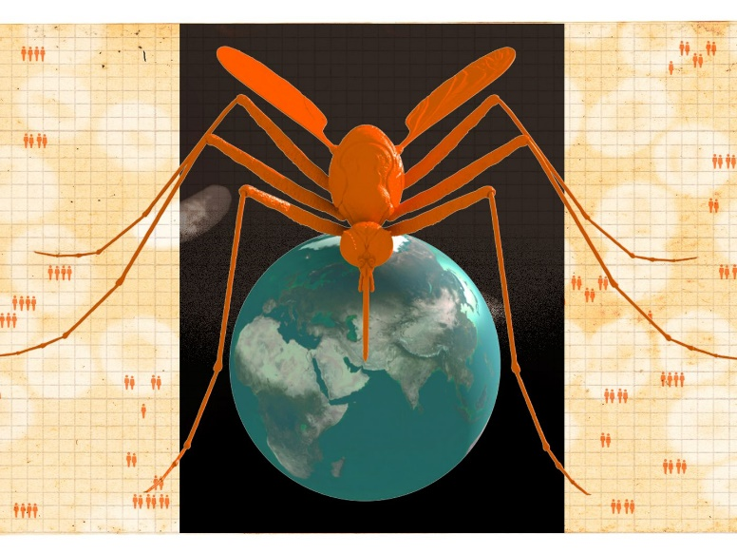
INTRODUCTION
Mosquitoes mostly being the home for arboviruses.
Aedes Aegypti, One such species of mosquito considered to be a serious threat after the outburst of zika virus in brazil and some parts of USA.
As there is no vaccine or drug available to cure, this is becoming an alerting issue for mankind.
We use a methodology in which genetically modified mosquitoes mate resulting in no offspring's such that it suppresses the population of mosquitoes.
We use Agent Based Modelling to create a model which represent the mosquito problem scenario.
The primary goal of this model is to help the user choose the ideal locations and quantities of GMO male mosquitoes to release while providing the most effective results for the practice.

Slide 3
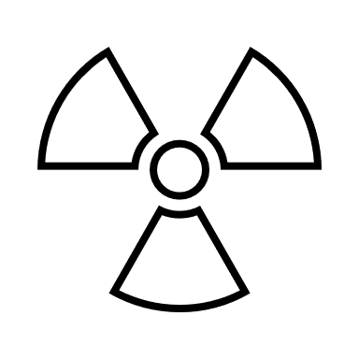
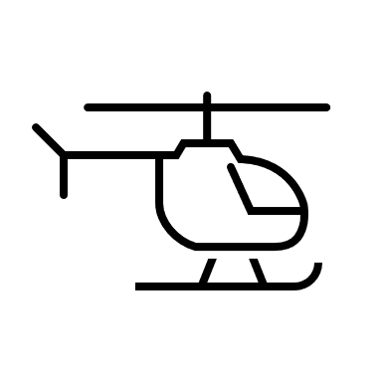


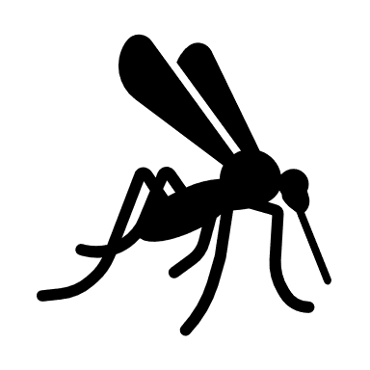
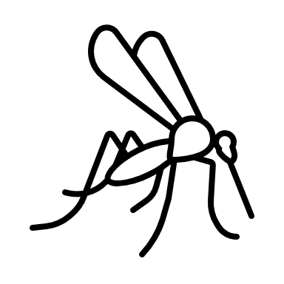


Sterile Insect Technique (SIT)
The sterile insect technique (SIT) is a control strategy that uses radiation to produce genetic mutations or chromosomal breaks to generate sterile adult insects. These sterile insects are released into the wild to suppress and eventually eradicate wild populations.
The below figure shows the working principle of the SIT technique.
Mass rearing of mosquitoes takes place in special facilities
Male and Female mosquitoes are separated and there by making male ones sterile by radiation
Sterile male insects are released over affected areas (towns, cities, etc.,).
Mating with wild mosquitoes are done.
Eggs produced by females that are infertile and bear no offspring, there by reducing the population.

Slide 4
Release of Insect Carrying Dominant Lethal [RIDL]
The advancement of SIT lead to a technique called RIDL.
Release of Insects carrying Dominant Lethal (RIDL) is a control strategy using genetically engineered insects that have (carry) a lethal gene in their genome (an organism's DNA).
Here, the radiation part in SIT is replaced with genetically modified mosquitoes, thereby giving higher flexibility.
There are two types of RIDL techniques as shown below:
Bi-Sex RIDL:
In Bi-Sex Release of Insect Carrying Dominant Lethal technique the heterozygous offspring are killed by the inherited lethal gene.
Bi-sex RIDL will cause that both male and female offspring die before adulthood.
FS-RIDL:
Female Offspring's will die at the end.
Heterozygous male offspring's will be alive.

Slide 5
Why Fs-RIDL Over Bi-Sex RIDL?
Bi-Sex RIDL method requires repeated releases of the GMO mosquitoes(engineered mosquitoes) into the wild.
Bi-Sex RIDL could significantly reduce the population but hard to eradicate a mosquito population entirely.
Fs-RIDL (female specific) targets the female offspring, ensuring they fail to survive until adulthood.
In Fs-RIDL , male offspring will mature with the lethal gene and continue to mate with another wild female. In favorable circumstances the modified gene is spread automatically.
Therefore, reducing the number of females will clearly lead to a reduction in the total population in the next generation, this strategy controls, and may ultimately eradicate the target population. Hence, we prefer Fs-RIDL over Bi-Sex RIDL.

Slide 6
Agent Based Modelling
Agent-based modelling is a type of modelling in which the focus is on representing agents (such as people or animals) and their interactions.
Agent-based models consist of dynamically interacting rule-based agents.
Verification and validation of simulation models is extremely important. Verification involves making sure the implemented model matches the conceptual model, whereas validation ensures that the implemented model has some relationship to the real-world.
The main advantages in using ABM to simulate the mosquito population suppression system.
Releasing GMO mosquitoes at different locations will cause different results. This promotes an increased level of user interaction that directly affects the resulting observed behavior.
Using a model based solely on equations could not show the actual situation in a wild environment. Therefore, designing and operating an agent-based model to simulate this system is the best way to help us visualize the most efficient way of using novel genetics-based strategies.

Slide 7
Why NetLogo?
To assist the development of Agent Based Modelling number of tools have came into existence, some of them are shown below.
Swarm
Mason
Repast
Star logo
Net logo
Any Logic
Many more….
NetLogo consists of a programming language (derived from the earlier Logo language) and a set of libraries, as well as a programming environment.
It provides a set of programming facilities, however NetLogo also provides a graphical tool for quickly constructing interfaces for running agent-based models.
In addition to the 2D spatial view, the developer adds other elements, such as buttons to set model parameters and graphs to monitor results.
All elements of the interface may be moved around easily as per our preference.

Slide 8
About Model
This model is an open unbound environment, where the mosquitoes can fly freely.
The user controls the release of GMOs(male) in terms of locations, quantities, and quantity of releases.
Assumptions:
Life expectancy – Males 3-10, Females 3-50
Compatibility value – 0-9
Max pregnancies in a lifetime – 0-3
Number of eggs laid per pregnancy – 0-299
Agent Relationships:
There are three types of agent-self interactions:
If not pregnant, female mosquitoes look for a male to mate
If pregnant, female mosquitoes find water to lay eggs
If lifetime decrease to zero, agents die.
There are two types of agent-agent interactions:
Wild male mate with wild female
GMO male mate with wild female
There are three types of agent- environment interactions:
Release GMO male at one or several release locations.
Female laid eggs at water patches.
Hatch eggs from water patches.
There is one type of environment-environment interaction:
Select a release location and move the location to another patch.

Slide 9





About Model
Agent Identification:
Identification of the agents are done with the color that is changed and their characteristics such as reproductive events and genetically modified(GMO) status.
Color | Sex | GMO Infected | Pregnant
 | Female | Wild – Non GMO | No
 | Female | Wild – Non GMO | Yes
 | Female | GMO | Yes
 | Male | Wild – Non GMO | Not Applicable
 | Male | GMO | Not Applicable

Slide 10
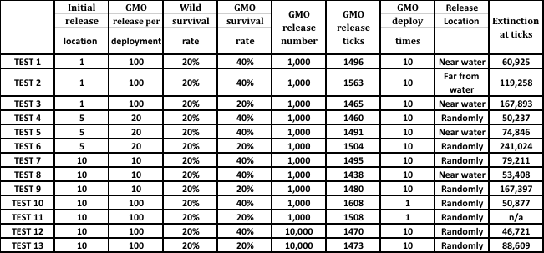
Experiments and Results
Overall, 13 test experiments were carried out. The main concept of experiments was to choose one variable to alter, while keeping the others constant. After that, we observed how the results would be affected by these alterations. All the results of these experiments were shown in table below.

Slide 11
Results

Slide 12
Conclusion
From all the tests conducted, we found several phenomena:
With the same GMO release number, the eradication time was accelerated by putting deployment points near the water, particularly when the number of deployment points is low.
With several release locations, the eradication efficiency was not significantly influenced by increased location numbers.
When the survival rate of GMO mosquitoes is above the survival rate of wild (non-GMO) mosquitoes, the eradication speed is faster.
Increasing the release times increased the possibility of eradication with the same GMO release number but did not significantly affect the efficiency of eradication.
Releasing only one time may cause none of the GMO mosquitoes to survive and the mission will fail .
Increasing the GMO release number from 1000 to 10000 would give us a decrease return to scale, but it is not efficient at these high numbers.

Slide 13
References
[1] Burt A. Site-specific selfish genes as tools for the control and genetic engineering of natural populations. Proc Biol Sci. 2003; 270:921–928.
[2] Olson KE, Alphey LS, Carlson J, James AA. Genetic approaches in Aedes aegypti for control of dengue: an overview. In: Knols BGJ, Louis C, editors. Bridging Laboratory and Field Research for Genetic Control of Disease Vectors. Heidelberg: Springer; 2006.
[3] Alphey LS, Benedict MQ, Bellini R, Clark GG, Dame DA, et al. Sterile-insect methods for control of mosquito-borne diseases: an analysis. Vector-Borne Zoonot. 2010; 10:295–311.
[4] Sinkins S, Gould F. Gene drive systems for insect disease vectors. Nat Rev Genet. 2006; 7:427–435.
[5] Papathanos P, Bossin H, Benedict MQ, Catteruccia F, Malcolm C, et al. Sex separation strategies: past experience and new approaches. Malar J. 2009;8: S5.
[6] Catteruccia F, Crisanti A, Wimmer E. Transgenic technologies to induce sterility. Malar J. 2009;8: S7.
[7] Labbé, Geneviève M C et al. “Female-specific flightless (fsRIDL) phenotype for control of Aedes albopictus.” PLoS neglected tropical diseases vol. 6,7 (2012) : e1724. doi : 10.1371/journal.pntd.0001724
[8] Thomas DD, Donnelly CA, Wood RJ, Alphey LS. Insect population control using a dominant, repressible, lethal genetic system. Science. 2000 Mar 31;287(5462):2474-6. doi: 10.1126/science.287.5462.2474. PMID: 10741964.
[9] G. Allen, “Genetically Modified Mosquitoes Join the Fight to Stop Zika Virus,” 26-Jan-2016. [Online]. Available: https://www.npr.org/sections/goatsandsoda/2016/01/26/464464459/genetically-modified-mosquitoes-join-the-fight-to-stop-zika-virus. [Accessed: 11-Oct-2020].
[10] “Netlogo-Software Used” [Online]. Available: https://ccl.northwestern.edu/netlogo/. [Accessed: 11-Oct-2020].

Slide 14
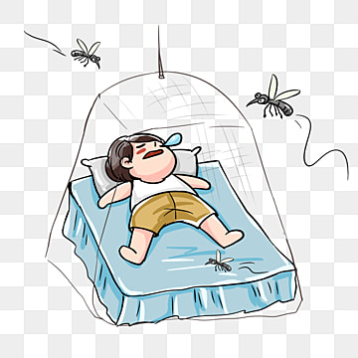
THANK YOU

